Slide 1
“YOUR FIRST NAME IN SOURCING”

Slide 2
With over 35 years experience in strategic sourcing, Tricord International listens to your needs and configures sourcing solutions according to your specific sourcing needs and goals.

Slide 3
On average, our customers realize a 20 to 30 percent cost savings via long-term, robust partnerships we have established with our supplier partners. In short, we increase your margins while also relieving your headaches with supplier compression, quality control, logistics and inventory management.

Slide 4
There is no need for you to continue experiencing pain with the tariffs in China. We have established a reliable supply chain in India with a team on the ground overseeing production, giving us a strong advantage over our competition.
Our Global “footprint” with India, China, Taiwan, Turkey, and others, has allowed Tricord to establish strategic partnerships to source the engineered, made-to-print parts you need.

Slide 5
Here is what is included in Tricord International’s strategic sourcing management…

Slide 6
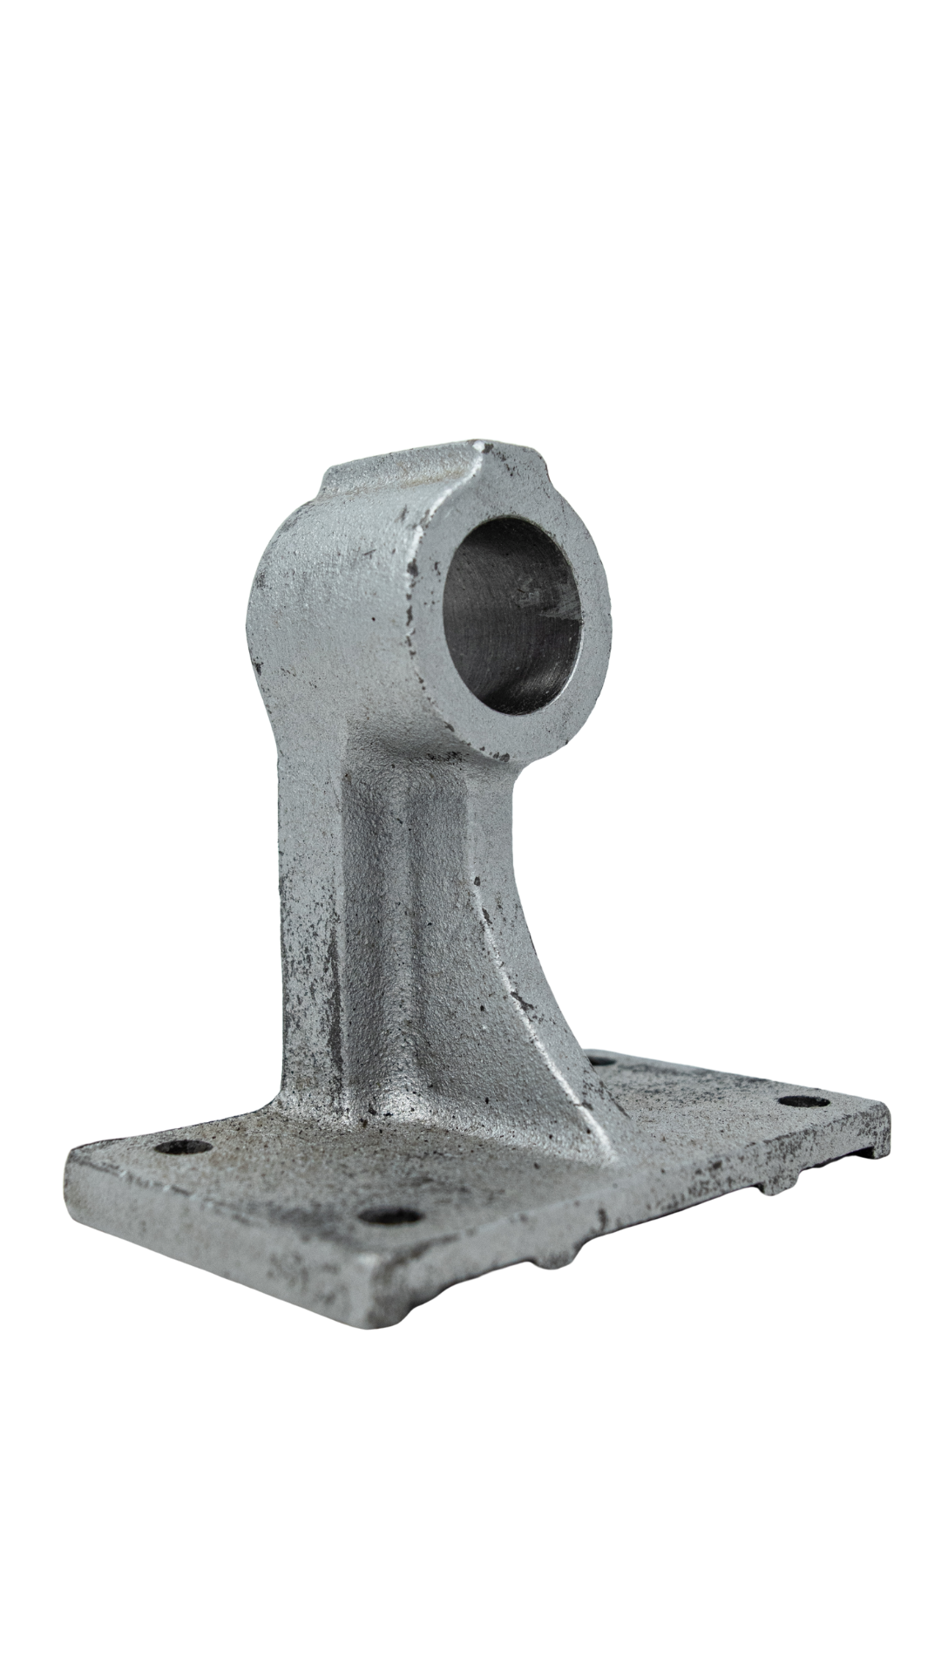
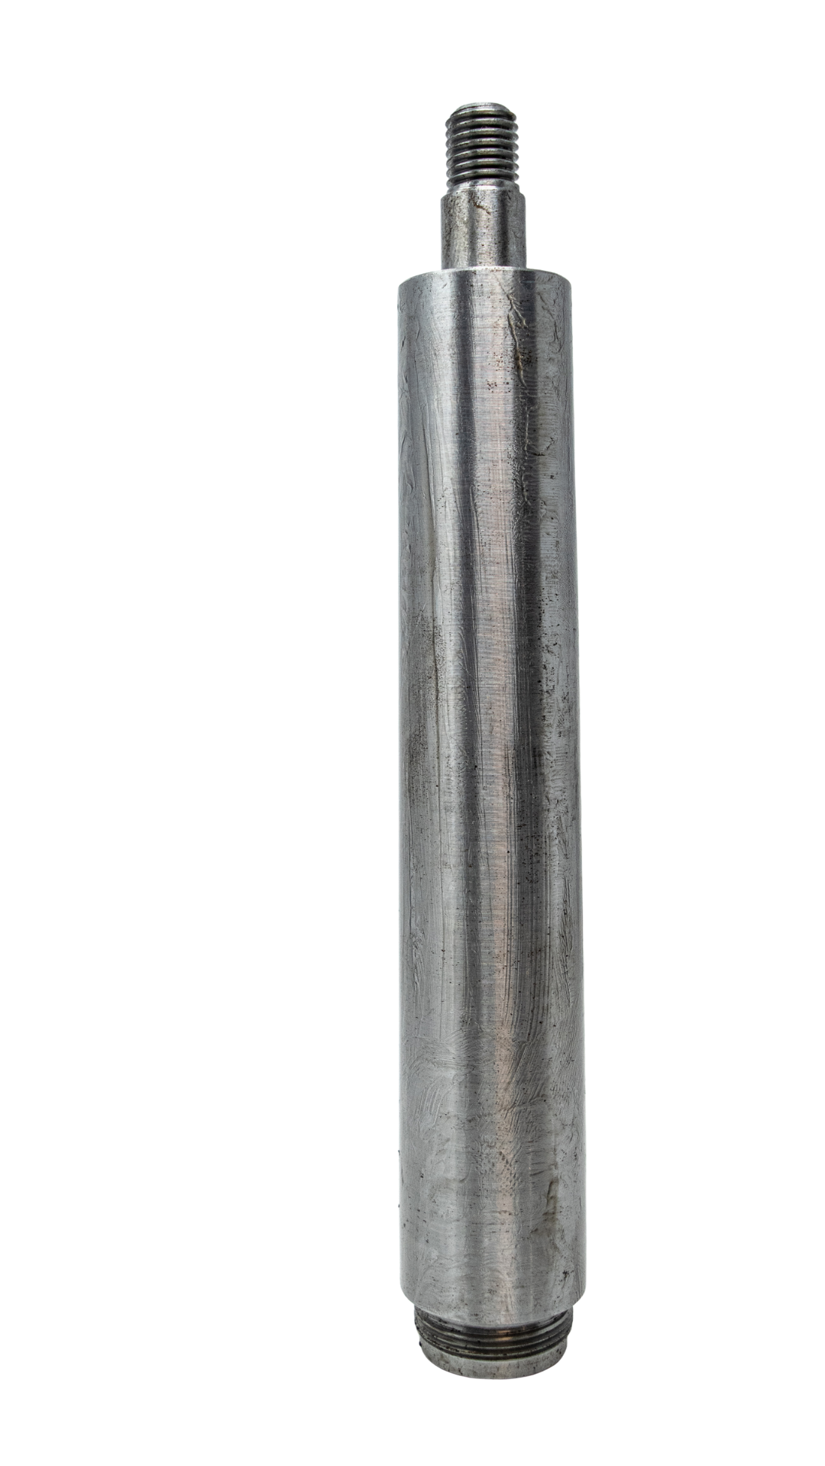
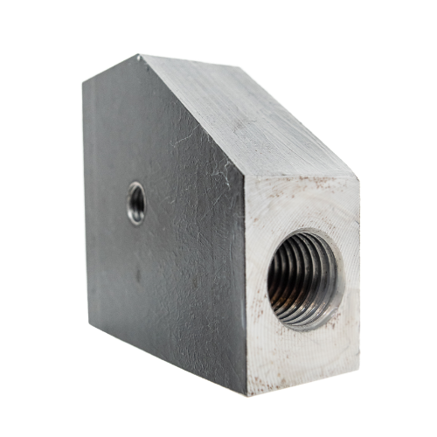
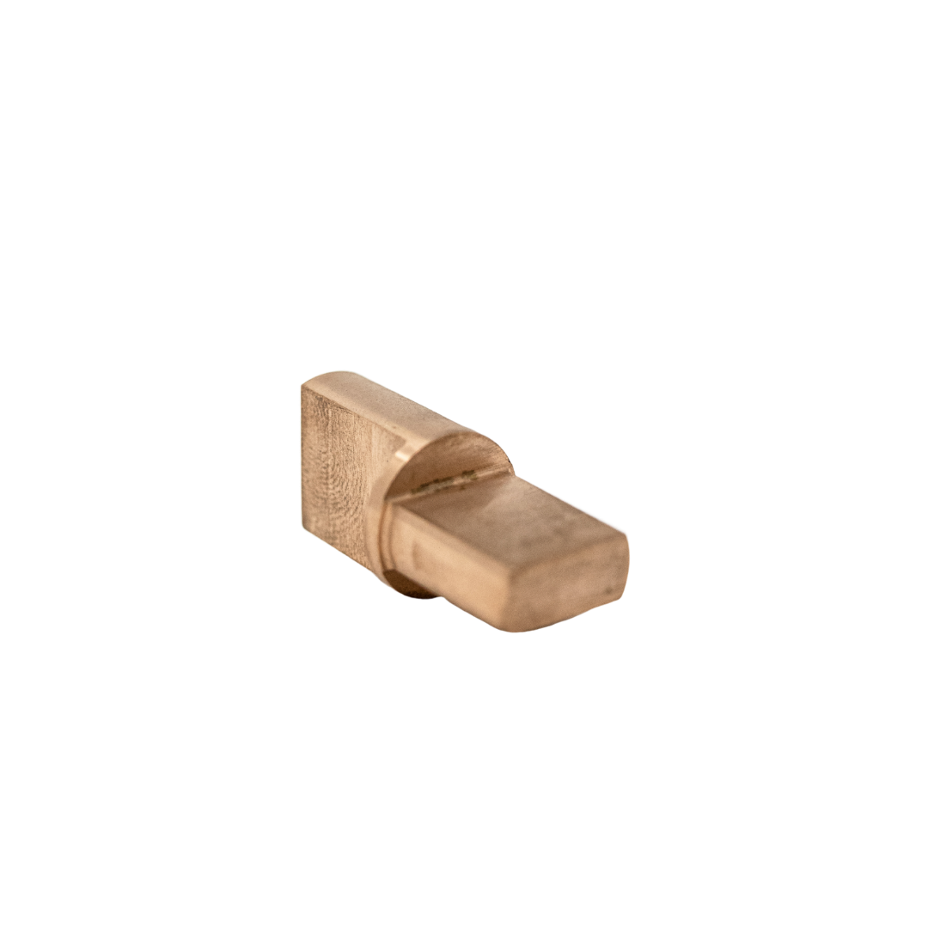
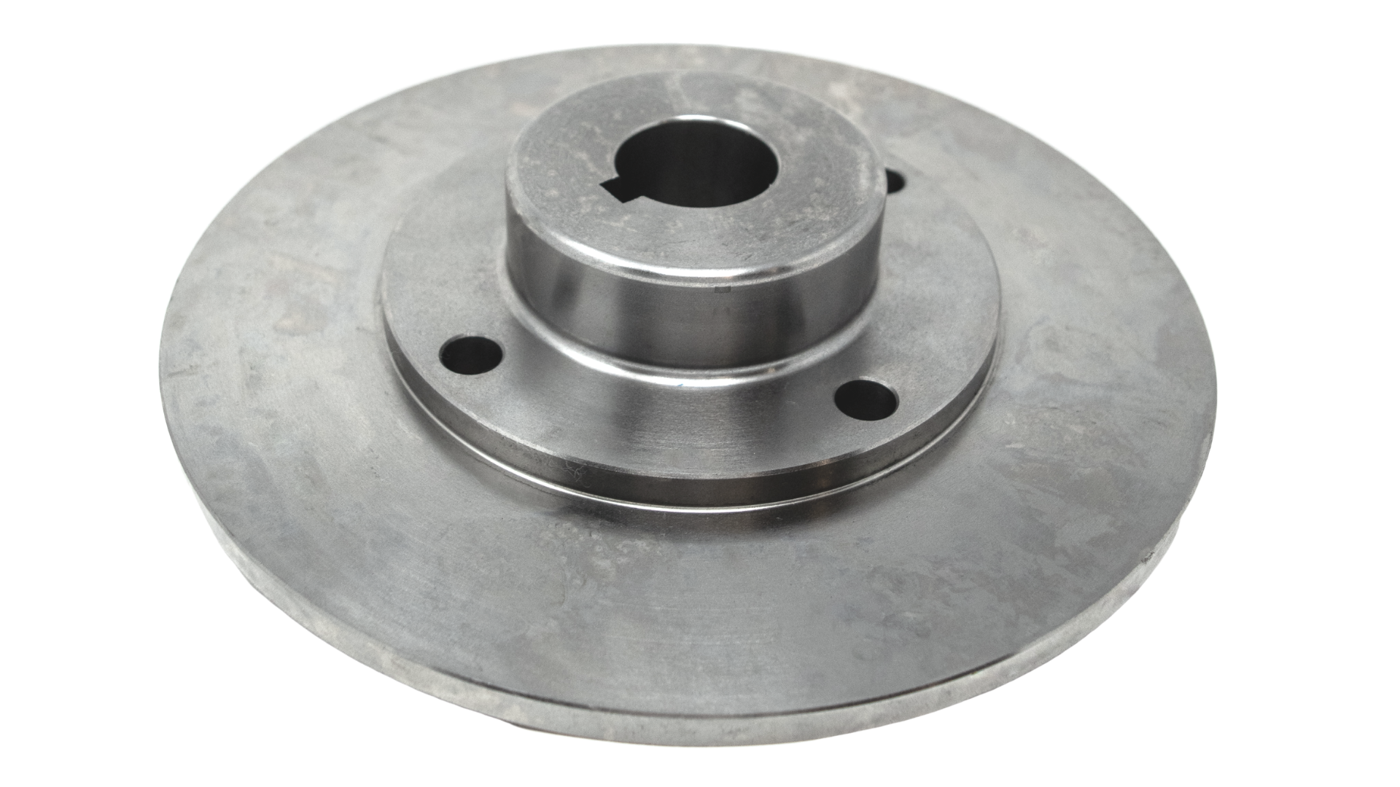
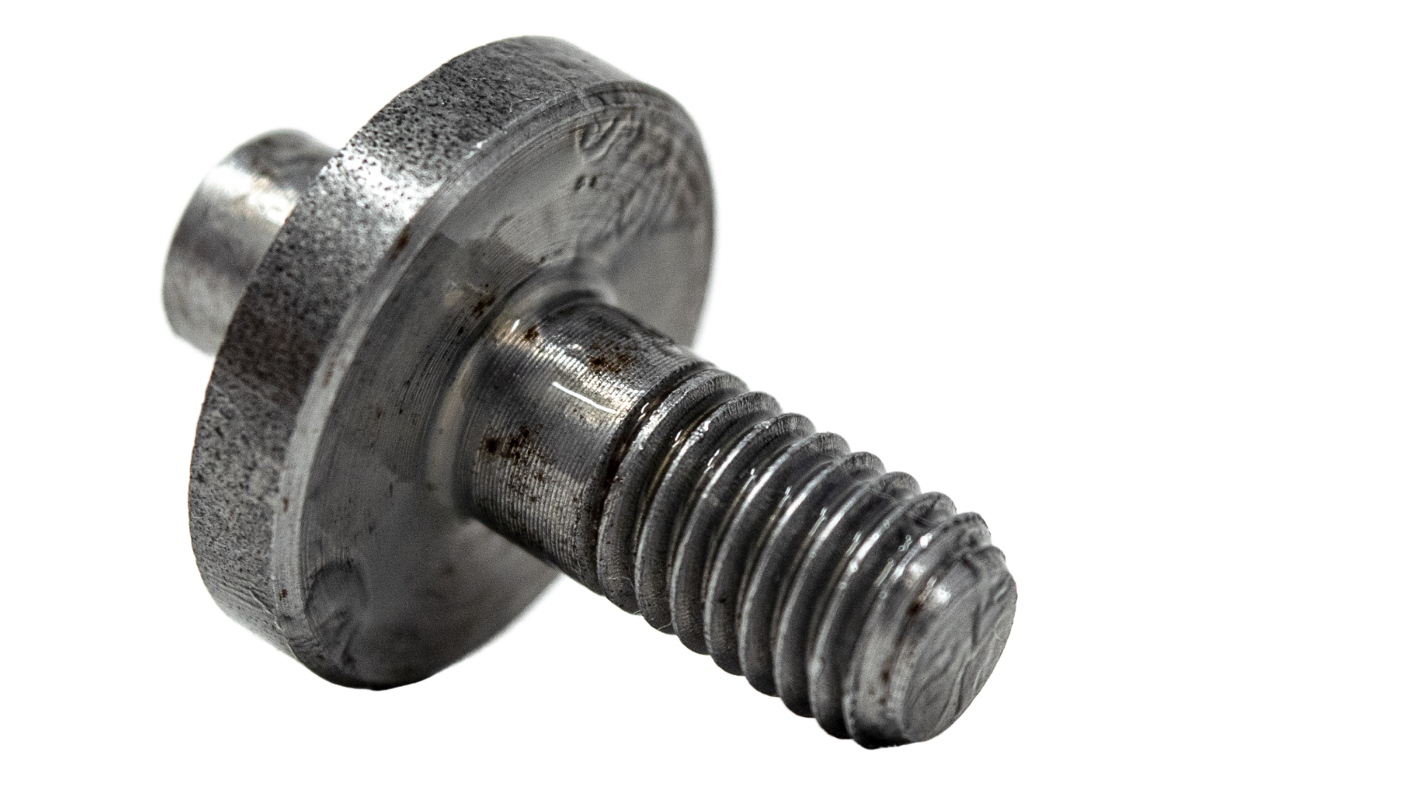
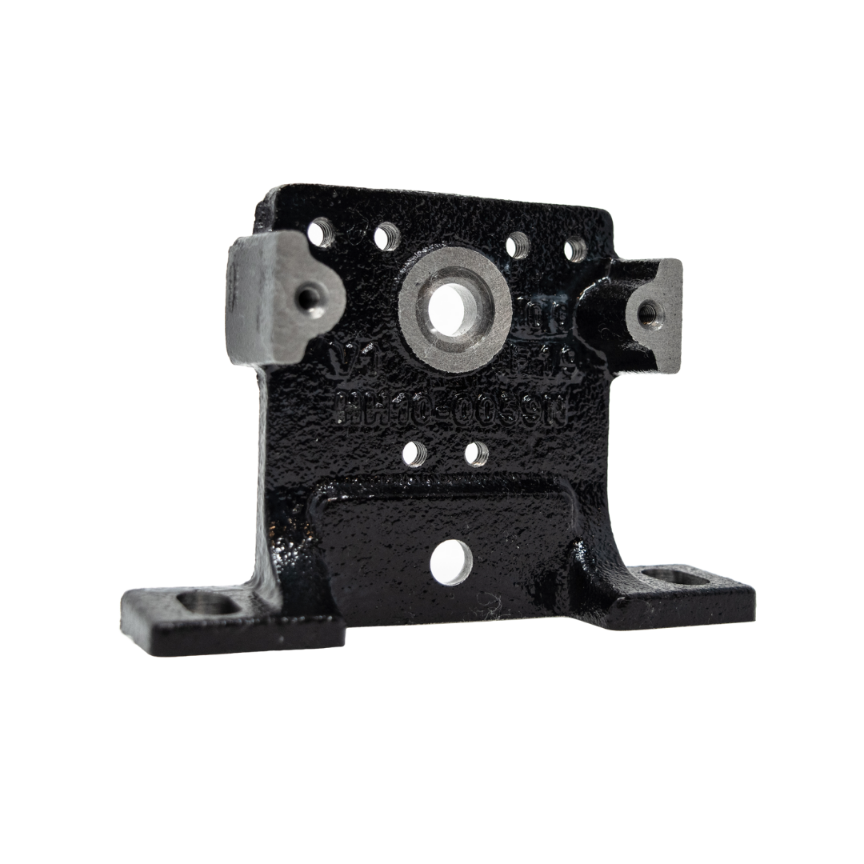
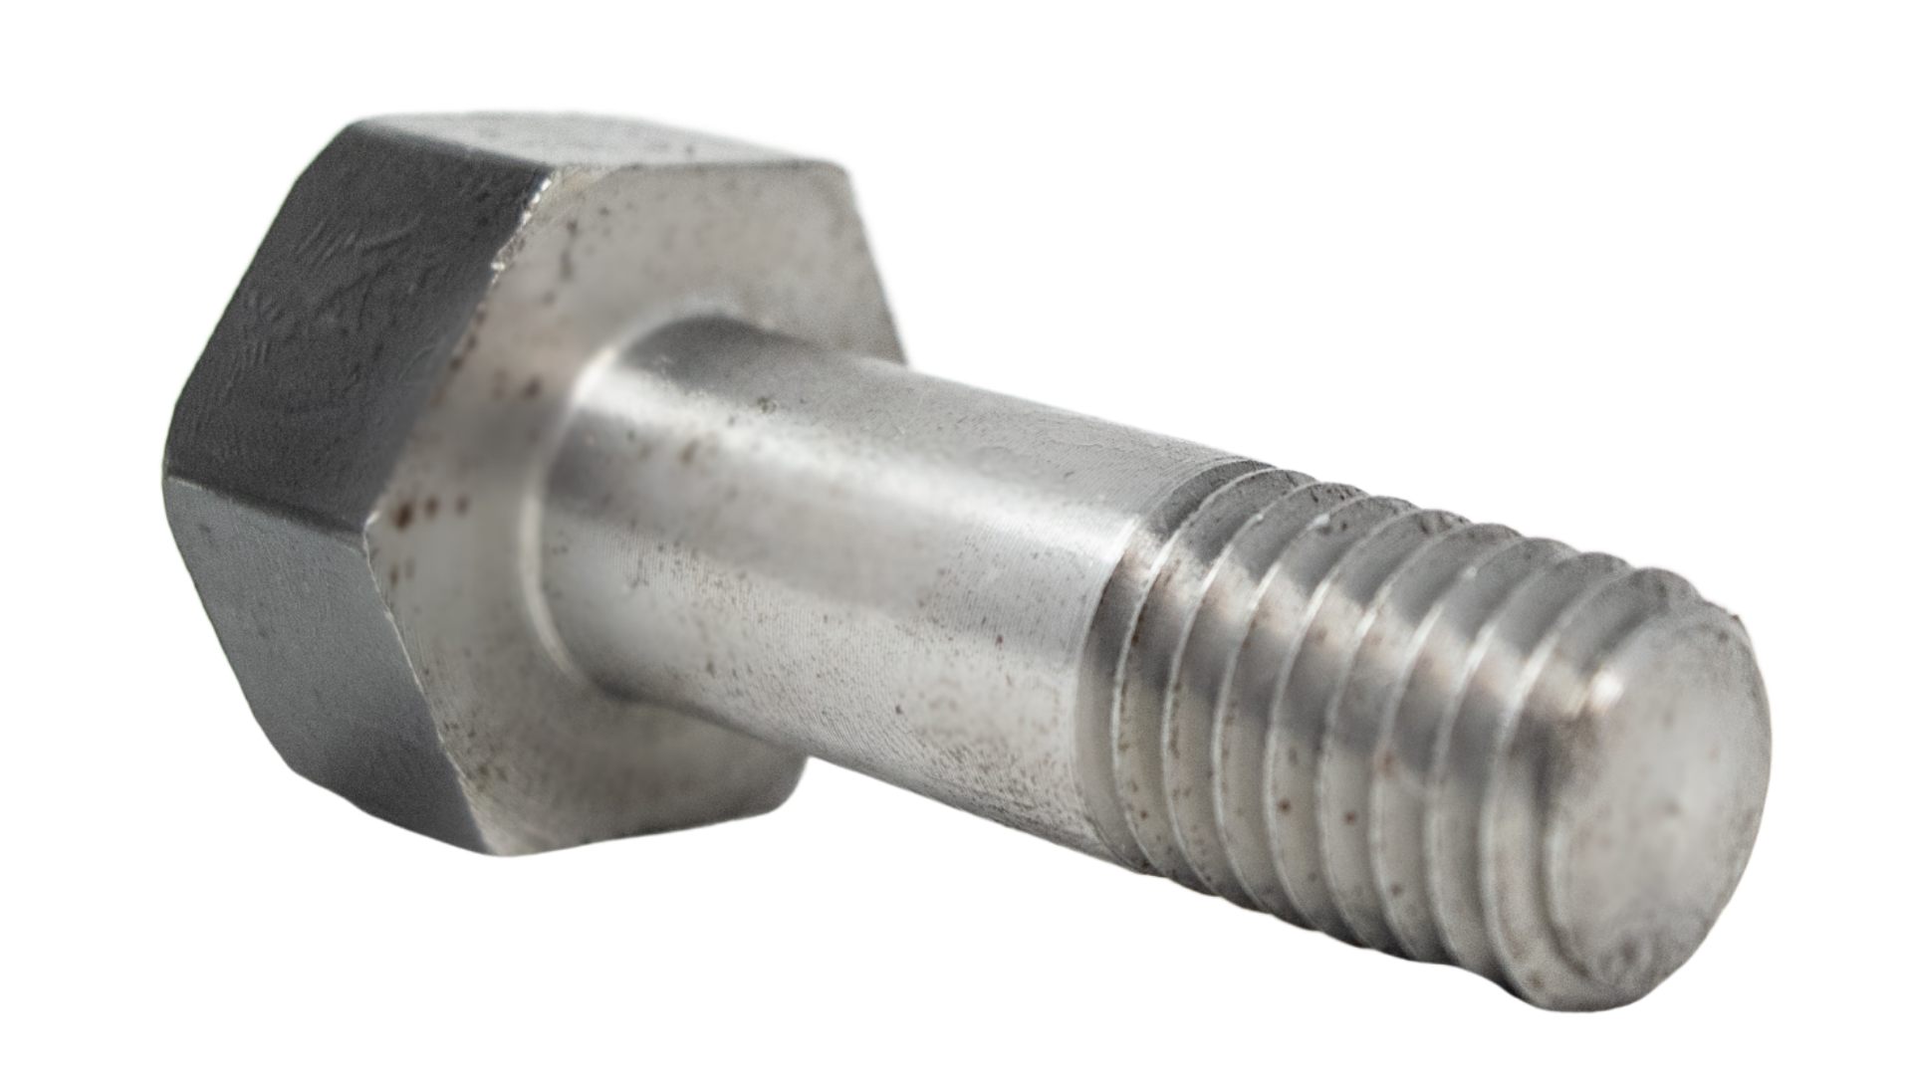
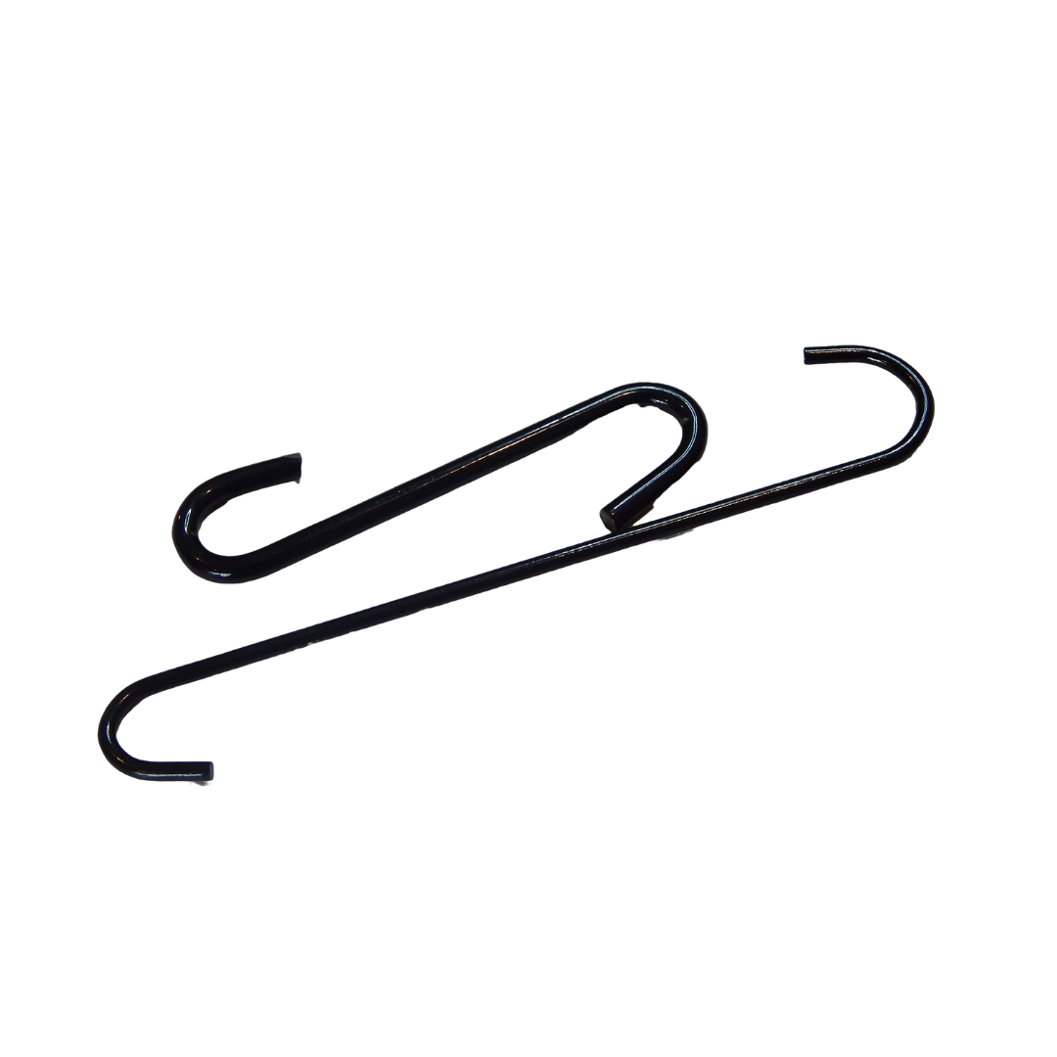
MANUFACTURING CAPABILITIES
Castings (less than 1lb to 400lbs+; Ferrous and Non-Ferrous)
Machined Parts (Small to Large diameters; tolerances of +/-0.001)
Machined Shafts
Stampings
Forgings
Fabricated Parts and Sub-Assemblies
Injection Moldings
Springs
Extrusions
Laser cuttings
Wire Forms

Slide 7
ENGINEERING SOLUTIONS
Tricord has a State-side team in place to meet your engineering needs and eliminate your quality issues with our…
In-house Engineering Team
Quality Systems
Reverse engineering
CAD/CAM drawings
Level 3 PPAP
Statistical Process Control (SPC)
3rd Party in-country inspection process
Material testing
Poke-yoke

Slide 8
END-TO-END FREIGHT MANAGEMENT
FCL & LCL
Air Cargo
Customs & Duties
Expedites

Slide 9
VENDOR-MANAGED INVENTORY
If keeping a stateside safety stock is a concern, we have the solution with…
60 to 90 day safety stock of your products
Release schedules
Packaging & Kitting
Labeling
Lot control

Slide 10
OUR CUSTOMERS
“Our mission is to provide our customers with first-class manufacturing while increasing their margins and helping them simplify the sourcing process. “

Slide 11
Pricing, Quality, or Delivery PAIN?
CONTACT US!
(334)-649-6889
www.tricordintl.com
1401 Fairview Ave., Prattville, AL 36066
info@tricordintl.com

